Slide 1


Nguyen Quynh Nhu HO
November 29, 2023

Slide 2

Outline
Executive Summary
Introduction
Methodology
Results
Conclusion
Appendix

Slide 3
Executive Summary
Summary of methodologies
Data were collected with several ways
Machine learning models were built
Data visualizations were created
Summary of all results
The optimal model was acquired
Visualizations were great for decision making

Slide 4
Introduction
Project background and context
In this project we work in SpaceX company data.
Problems that need answers
Which factors are behind the failure of landing?
Will the rockets land successfully?

Slide 5


Slide 6
Methodology
Executive Summary
Data collection methodology:
With Rest API
Perform data wrangling
Perform exploratory data analysis (EDA) using visualization and SQL
Discovering new patterns in the data with visualization techniques
Perform interactive visual analytics using Folium and Plotly Dash
Dash and Folium
Perform predictive analysis using classification models
Classification machine learning models

Slide 7
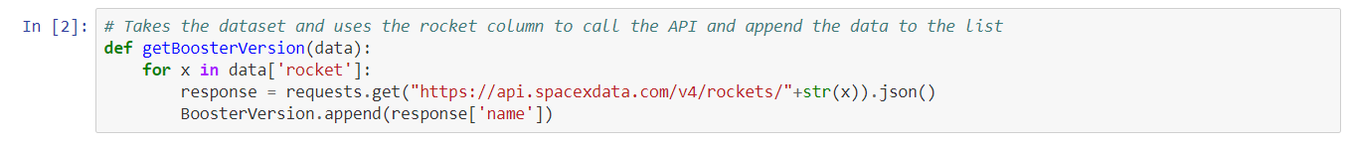
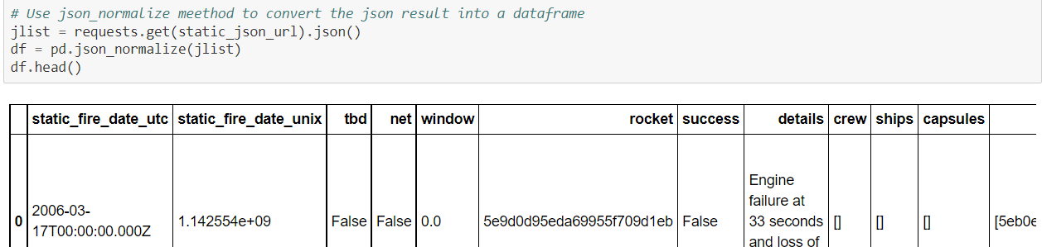
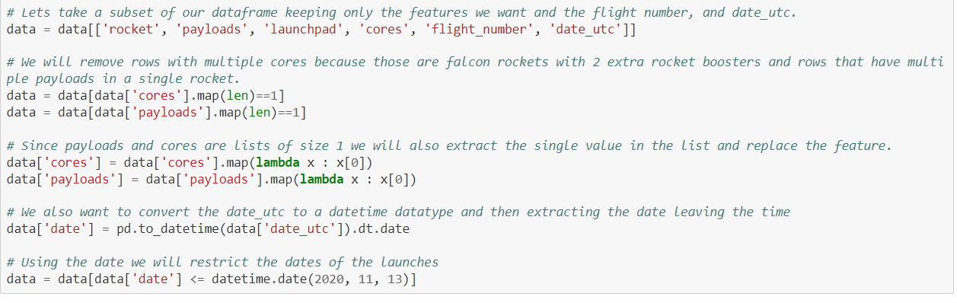
Data Collection – SpaceX API
7

Slide 8
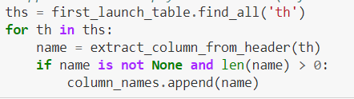
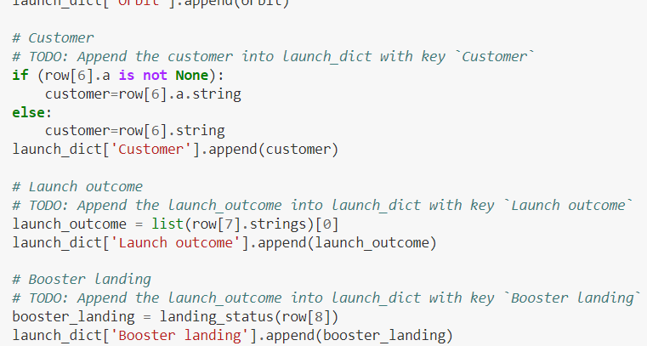
Data Collection - Scraping

Slide 9
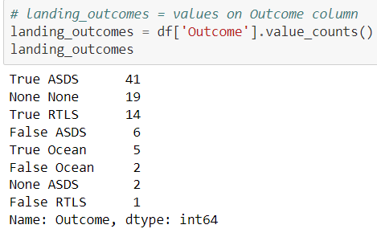
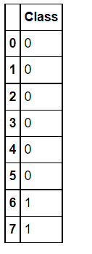
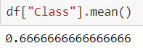
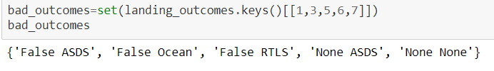
Data Wrangling

Slide 10
EDA with SQL
SQL queries to
Display the names of the unique launch sites in the space mission
Display the total payload mass carried by boosters launched by NASA (CRS)
Display average payload mass carried by booster version F9 v1.1
List the date when the first successful landing outcome in-ground pad was achieved
List the total number of successful and failure mission outcomes

Slide 11
Build an Interactive Map with Folium
folium.Marker() was used to create marks on the maps.
folium.Circle() was used to create a circles above markers on the map.
folium.Icon() was used to create an icon on the map.
folium.PolyLine() was used to create polynomial line between the points.
folium.plugins.AntPath() was used to create animated line between the points.
markerCluster() was used to simplify the maps which contain several markers with identical coordination.

Slide 12
Build a Dashboard with Plotly Dash
Dash and html components were used as they are the most important thing and almost everything depends on them, such as graphs, tables, dropdowns, etc.
Pandas was used to simplifying the work by creating dataframe.
Plotly was used to plot the graphs.
Pie chart and scatter chart were used to for plotting purposes.
Rangeslider was used for payload mass range selection.
Dropdown was used for launch sites.

Slide 13
Results
Exploratory data analysis results
Predictive analysis results

Slide 14


Slide 15
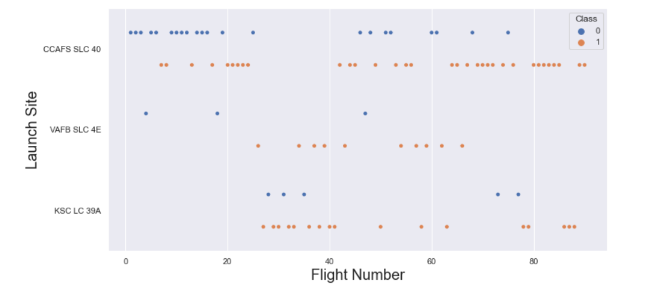
Flight Number vs. Launch Site

Slide 16
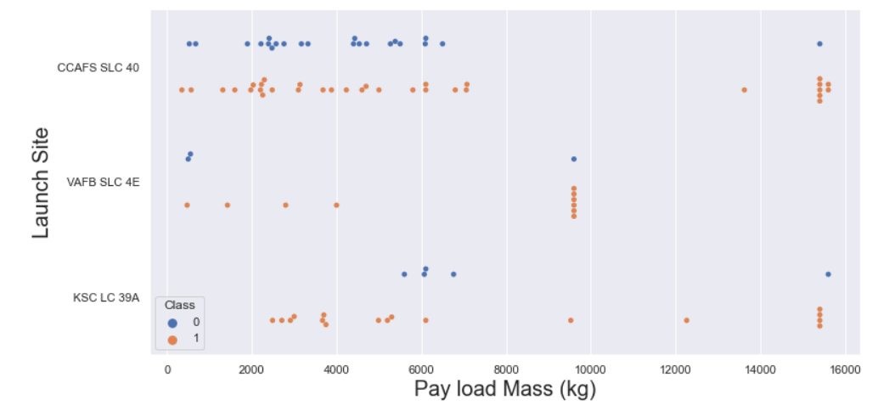
Payload vs. Launch Site

Slide 17
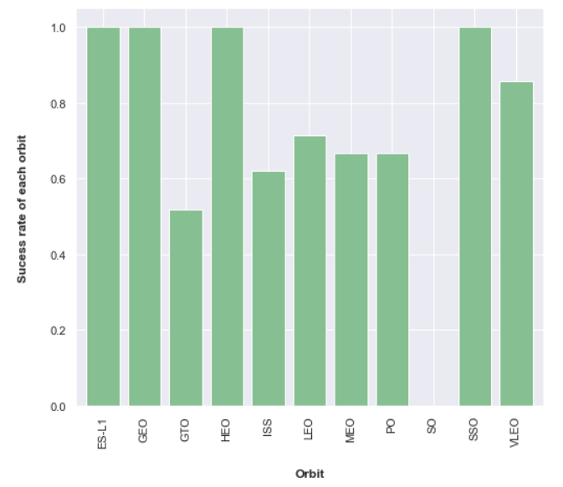
Success Rate vs. Orbit Type

Slide 18
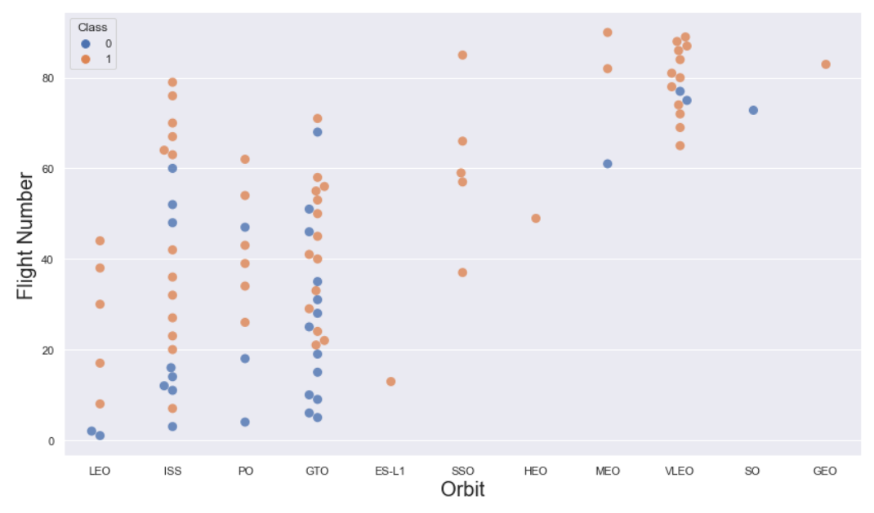
Flight Number vs. Orbit Type

Slide 19
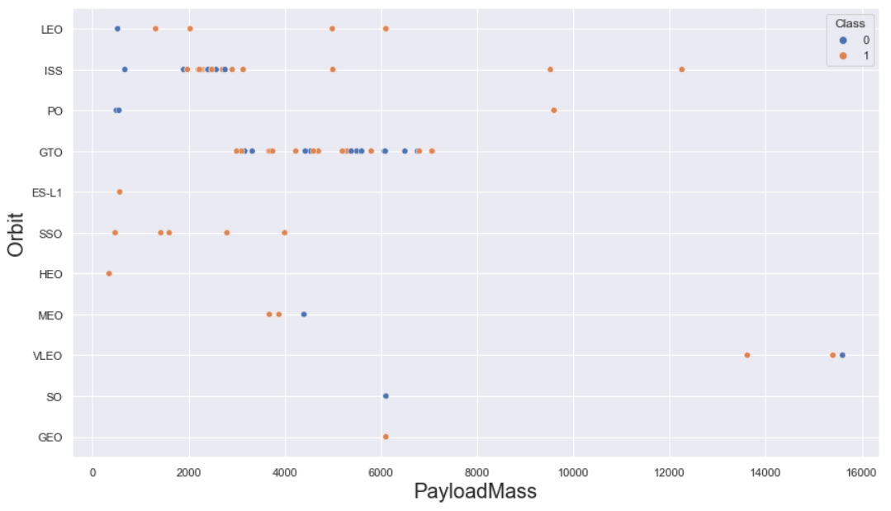
Payload vs. Orbit Type

Slide 20
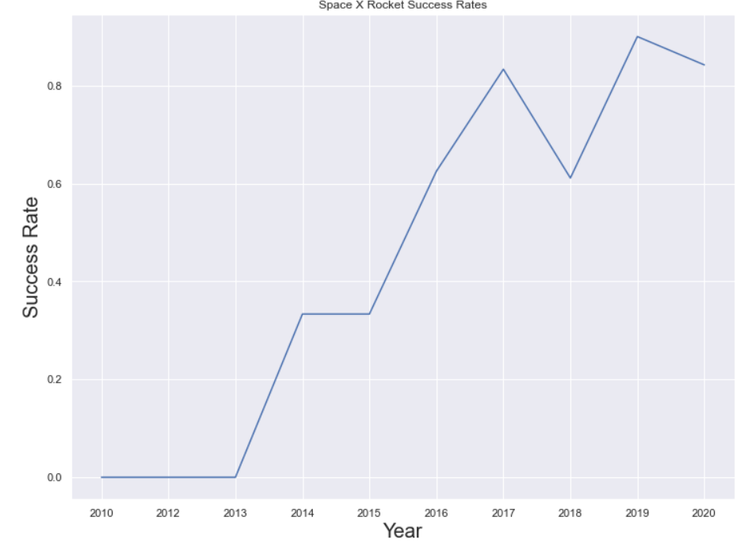
Launch Success Yearly Trend

Slide 21
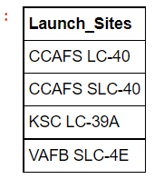
All Launch Site Names

Slide 22
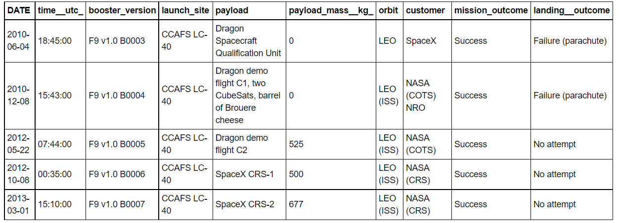
Launch Site Names Begin with 'CCA'

Slide 23
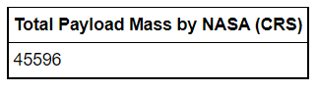
Total Payload Mass

Slide 24
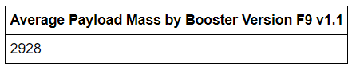
Average Payload Mass by F9 v1.1

Slide 25
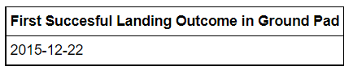
First Successful Ground Landing Date

Slide 26
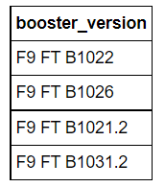
Successful Drone Ship Landing with Payload between 4000 and 6000

Slide 27
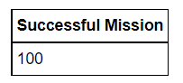
Total Number of Successful and Failure Mission Outcomes

Slide 28
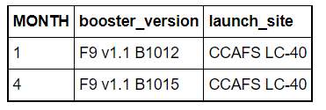
2015 Launch Records

Slide 29
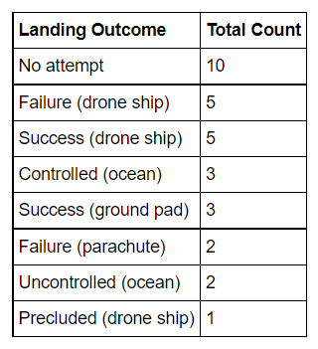
Rank Landing Outcomes Between 2010-06-04 and 2017-03-20

Slide 30


Slide 31
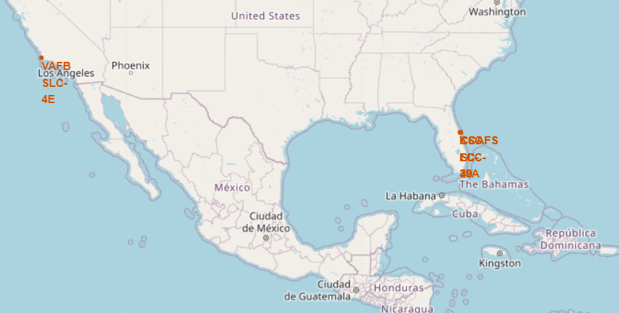
All Launch Sites’ Location Markers

Slide 32
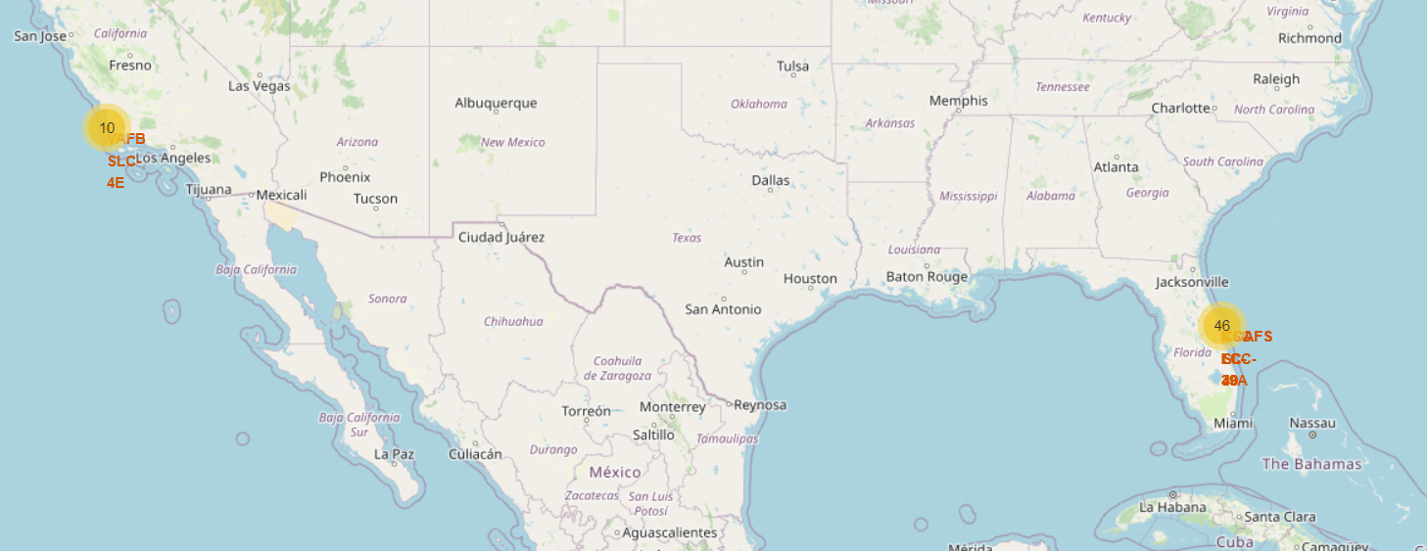
Color-labeled Launch Outcomes

Slide 33
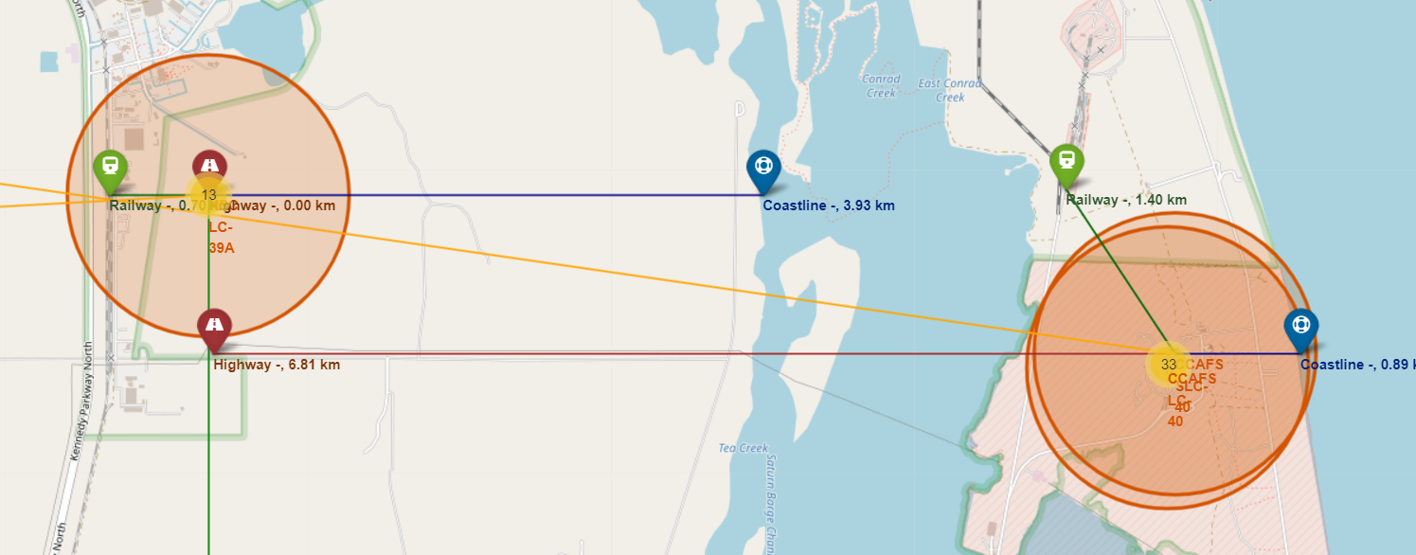
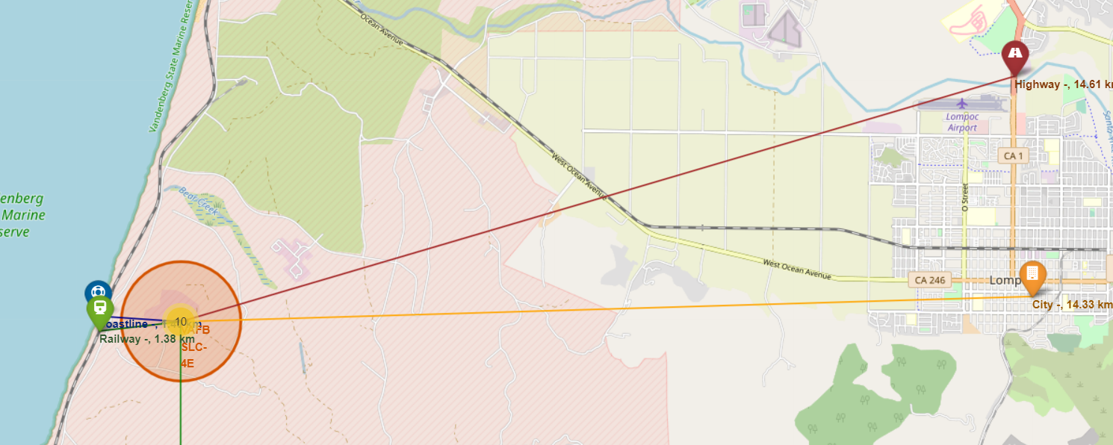
Launch Sites to its Proximities

Slide 34


Slide 35
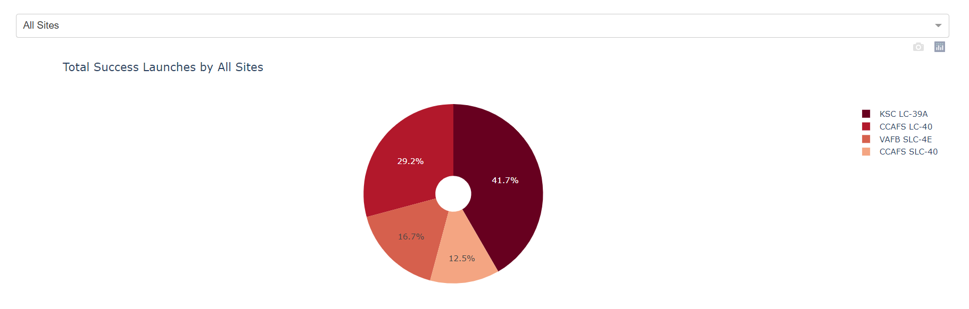
Launch Success Count

Slide 36
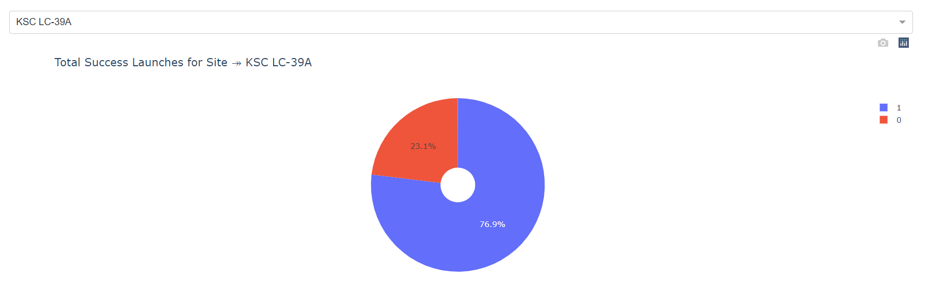
Launch Site with Highest Score

Slide 37
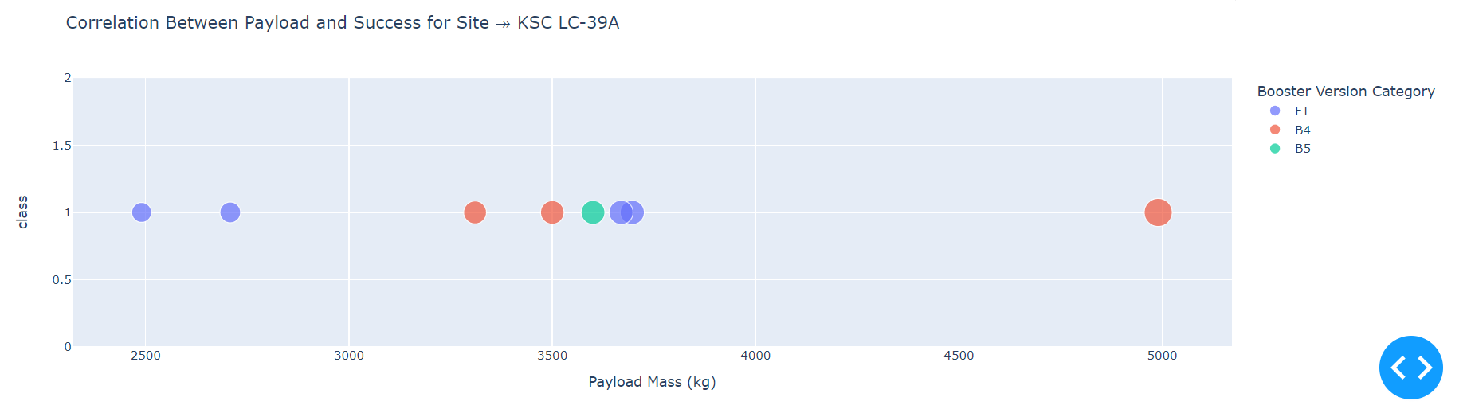
Payload vs. Launch Outcome

Slide 38


Slide 39
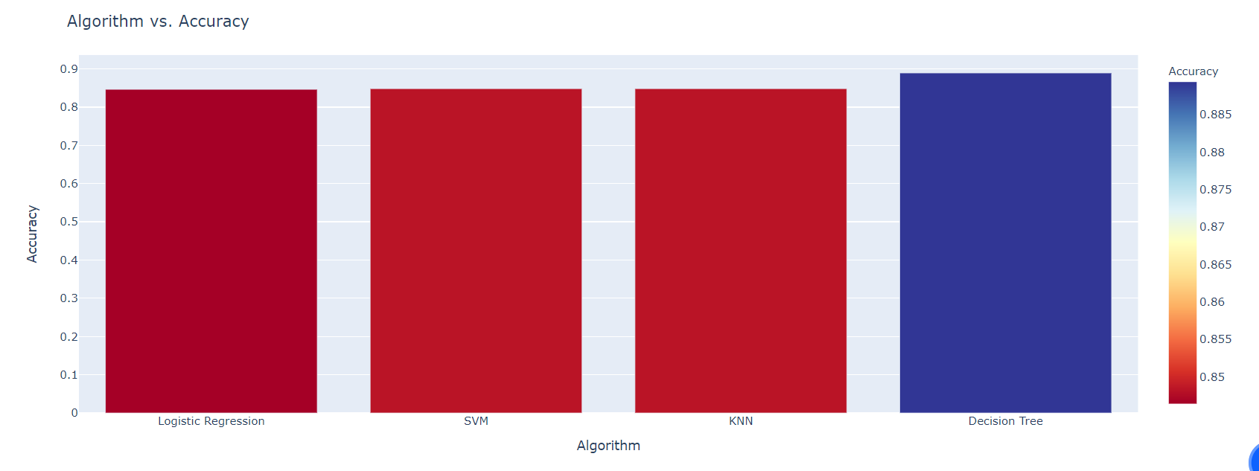
Classification Accuracy

Slide 40
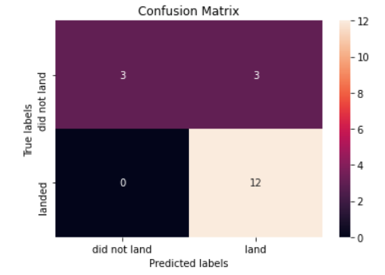
Confusion Matrix

Slide 41
Appendix
My GitHub
GitHub repo: https://github.com/Misa102/Data_Science_Capstone

Slide 42


